Slide 1
The Gender Equitable Briefing Policy – why you should sign up and how to comply
Moderator: Dr Kylie Weston-Scheuber
Discussion panel: The Honourable Justice Maxwell, President of the Court of Appeal; The Honourable Justice Quigley, President of VCAT; Richard Attiwill QC

Slide 2
Collection of data
Court of Appeal data publicly available
Supreme Court data collected from February 2017 to April 2018
Modelled on the “Visible Targets” data collected by Kate Eastman SC in NSW
Collected data from Austlii on:
Appearances by gender
Civil/criminal
Briefing entity (private/govt)
Does not include cases where no appearance entered, or heard on the papers
“Senior counsel” category includes all QC/SC and the leading counsel where two counsel appear together (whether QC/SC or not)

Slide 3
Collection of data
Supreme Court data
758 matters between Feb 2017 and April 2018
584 civil matters
174 criminal matters
A total of 2,232 counsel appeared in these matters, of which 1788 male and 444 female
621 male senior counsel appeared compared to 86 female counsel
1167 male juniors appeared compared to 358 female juniors

Slide 4
Collection of data
Limitations on data:
A draft analysis
No data for speaking role
May incorporate some incidental data on appearances by solicitors/self-represented if not reported correctly
Minor effects may be due to:
Single counsel briefed by multiple entities in a few cases
Small number of cases with multiple defendants where some counsel briefed by private entities and some counsel briefed by govt agencies
Multiple judgments with same counsel appearing not all accounted for

Slide 5
Percentages of counsel in Victoria
State of the Bar Survey, March 2018:
Women comprise 29% of all barristers
Women comprise 12% of silks
Women comprise more than 40% of barristers under both 10 and 15 years call

Slide 6
Financial Year 2016/2017 Victorian Court of Appeal Appearances & speaking roles by gender Criminal Hearings (Data Source: Victorian Court of Appeal website)

Slide 7
Financial Year 2017/2018 Victorian Court of Appeal Appearances & speaking roles by gender Criminal Hearings (Data Source: Victorian Court of Appeal website)

Slide 8
Financial Year 2016/2017 Victorian Court of Appeal Appearances & speaking roles by gender Civil Hearings (Data Source: Victorian Court of Appeal website)

Slide 9
Financial Year 2017/2018 Victorian Court of Appeal Appearances & speaking roles by gender Civil Hearings (Data source: Victorian Court of Appeal website)

Slide 10
Supreme Court of Victoria Appearances by Gender Feb 2017 - April 2018 OVERVIEW

Slide 11
Supreme Court of Victoria Appearances by Gender Feb 2017 - April 2018 Criminal Hearings

Slide 12
Supreme Court of Victoria Appearances by Gender Feb 2017 - April 2018 Civil Hearings

Slide 13
Supreme Court of Victoria Briefing by gender Feb 2017 – Apr 2018 Government

Slide 14
Supreme Court of Victoria Briefing by gender Feb 2017 – Apr 2018 Private entities

Slide 15
General observations
In both the Court of Appeal and Supreme Court, women are appearing in a lower percentage of matters than their percentage at the Bar would indicate
Appearance rates are higher in criminal matters than civil matters
There has been little improvement in appearance rates in civil or criminal matters between 2016/2017 and 2017/2018 (Court of Appeal)
In civil matters, women appear at rates significantly less than their percentage at the Bar (15% compared to 29%, with speaking roles in only 7% of matters – 2017/2018)

Slide 16
General observations
In the Supreme Court, in criminal matters, women appear at rates roughly commensurate with their percentages at the Bar (senior and junior)
In the Supreme Court, in civil matters:
female senior counsel appear at rates roughly commensurate with their percentage at the Bar (12%)
Female junior counsel appear at rates significantly lower than their percentage at the Bar (19% compared to >29%)

Slide 17
Briefing entities
Government entities (State/Federal combined) are briefing women at rates at least commensurate with (or higher than) their percentages at the Bar:
24% of senior counsel briefed are women
41% of junior counsel briefed are women
Private entities are briefing women at rates lower than their commensurate percentages at the Bar:
9% of senior counsel briefed are women (cf 12% of senior counsel are women)
19% of junior counsel briefed are women (cf <29% of junior counsel are women)

Slide 18
WBA thanks:
Thank you to the following people who have assisted in research and data analysis:
Andrea Skinner, Susan Aufgang, Natalie Blok, Samantha Renwick (WBA)
Mary Michelle Connellan
Gabrielle Maginness
Audrey Rhodes
Kristen Tan
Genevieve Trinh

Slide 19
Court of Appeal – the Role of Junior Counsel practice note August 2018
The Court of Appeal encourages the active participation of junior counsel in cases where two counsel are briefed for a party.
The Court recognizes that junior counsel will typically have made a substantial contribution to the preparation of the case, and will best develop as advocates by being given opportunities to present argument.
Senior Counsel should feel no inhibition in dividing the appeal submissions between themselves and junior counsel or in asking junior counsel to make submissions in reply.

Slide 20
Gender Equitable Briefing Policy
Aims: to achieve a nationally consistent approach towards bringing about cultural and attitudinal change within the legal profession with respect to gender briefing practices
Available for adoption by all barristers
Sets short and long term targets and provides reporting obligations for briefing entities and barristers who adopt the Policy.

Slide 21
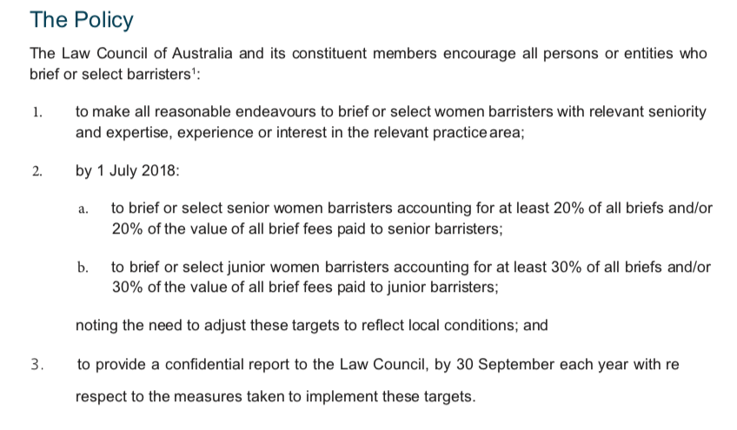
Gender Equitable Briefing Policy

Slide 22
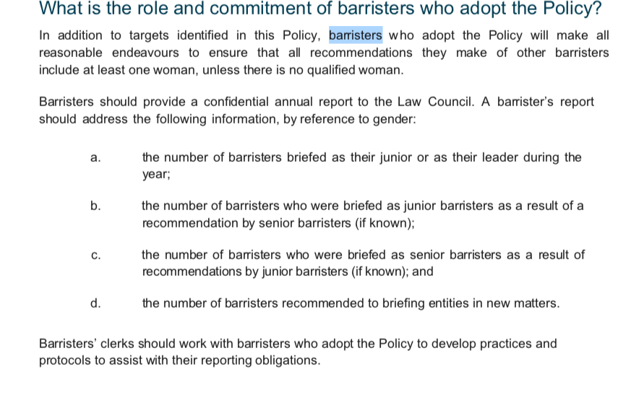
Gender Equitable Briefing Policy – for barristers

Slide 23
Victorian Bar Worksheet
WORKSHEET
(If more than one barrister has been recommended or briefed with you, use a separate line for each such barrister)
Date | Name or Type of Matter | New Matter? (Yes/No) | Recommendations made by a senior barrister (including by you if you are a senior barrister) (if known) |  |  | Recommendations made by a junior barrister (including by you if you are a junior barrister) (if known) |  |  | If briefed, other barristers briefed with you
 |  |  | Gender (Female/Male) | Senior/ Junior | Briefed? (Yes/No) | Gender (Female/ Male) | Senior/ Junior | Briefed? (Yes/No) | Gender (Female/Male) | Senior/ Junior

Slide 24
Victorian Bar Worksheet
“New matter” is a matter for which a barrister is asked to make a recommendation for the first time in the reporting year.
“Senior barrister” is a barrister of 10 years’ or more standing at the independent bar or who is a Queen’s Counsel or Senior Counsel and “junior barrister” means all other barristers.

Slide 25
Victorian Bar Worksheet
EQUITABLE BRIEFING POLICY ANNUAL REPORT
(Reporting period is 1 July to 30 June; report is due by 30 September)
Barrister Name:
Senior or Junior barrister:
Reporting Period:
Report Date:
TOTALS
(expressed as number of barristers)
Barristers briefed with you during the reporting period
Total female senior:
Total female junior:
Total male senior:
Total male junior:

Slide 26
Victorian Bar Worksheet
Barristers recommended by a senior barrister (including by you if you are a senior barrister) during the reporting period
Total female senior:
Total female junior:
Total male senior:
Total male junior:
Number briefed:
Barristers recommended by a junior barrister (including by you if you are a junior barrister) during the reporting period
Total female senior:
Total female junior:
Total male senior:
Total male junior:
Number briefed:
New matters in which you or other barristers made recommendations during the reporting period
Total number:

Slide 27
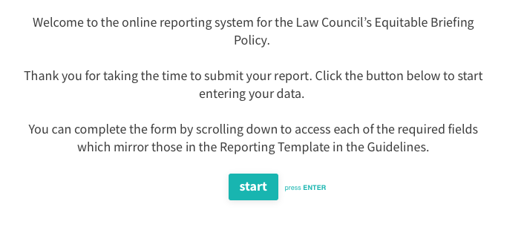
Law Council of Australia website reporting

Slide 28
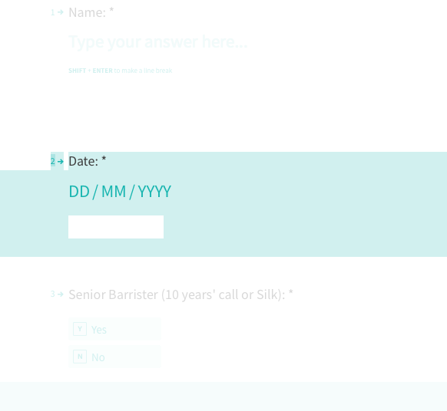
Law Council of Australia website reporting

Slide 29
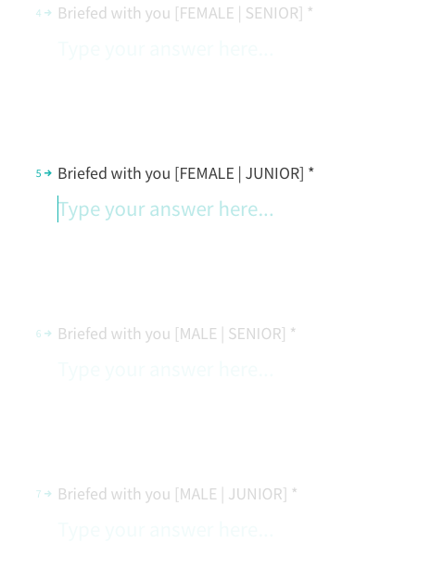
How to report annually

Slide 30
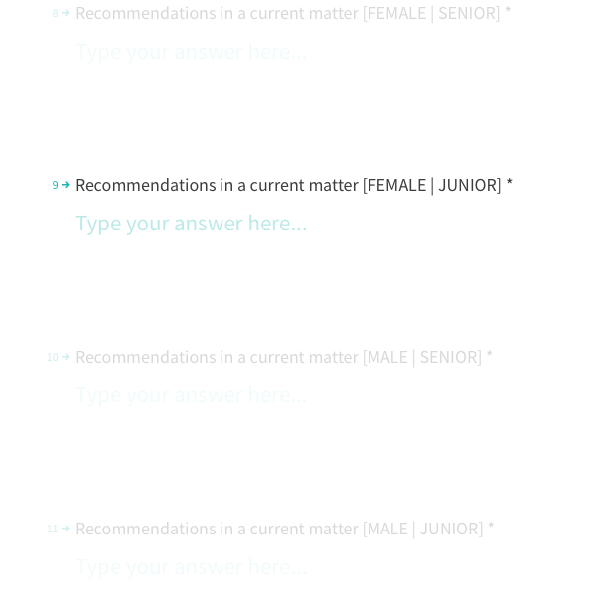
How to report annually

Slide 31
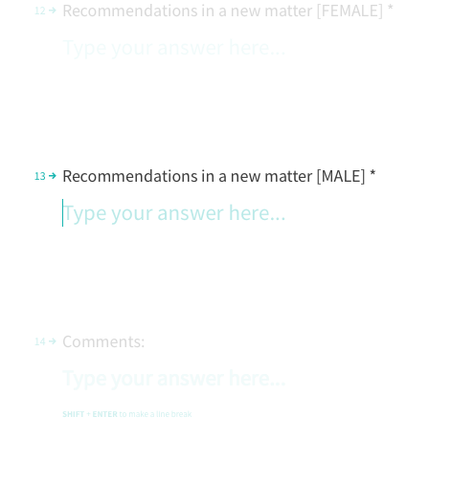
How to report annually

Slide 32
Useful resources
Law Council of Australia website:
https://www.lawcouncil.asn.au/policy-agenda/advancing-the-profession/equal-opportunities-in-the-law/national-model-gender-equitable-briefing-policy
Vicbar site on GEBP:
https://www.vicbar.com.au/members/community/equitable-briefing-gender-equality-bar
(including the Guide to Reporting and barrister worksheets)

